Slide 1
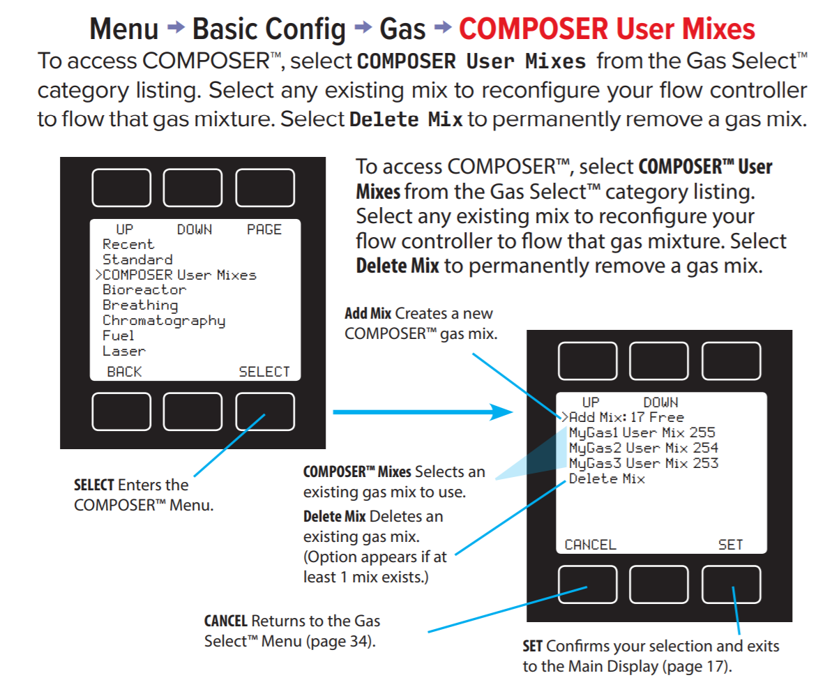
COMPOSER Custom Gas Mix

